Slide 1
Europe Mission and Challenges
APMC, Nairobi, Kenya, April 2023
Gh. Ritisan (Romania)

Slide 2
Pentecostal European network (pef & PEM)
In most European countries, the Pentecostal movement exists since the beginning of last century, being directly influenced by the revival that started on Azusa Street in USA.
There are around 5 million Pentecostals in Europe.
We have movements of tens of thousands and hundreds of thousands of members in Eastern Europe and the North-West (+ Italy), but also some movements with only a few thousands or hundreds of Pentecostal believers in certain smaller countries in the center of Europe or in the Balkans.
The European Pentecostals are connected together in PEF (Pentecostal European Fellowship), that at the moment has 60 members, from 38 countries, that organize a European conference each year.

Slide 3
Pentecostal European Mission (PEM)
PEM is the missions network of the PEF family, which connects & serves missions organizations and Pentecostal movements in Europe. We have 30 full PEM members and 7 associate members.
It was created in 1991. Arto Hamalainen played a key role in the birth of this network.
Our VISION is to see Pentecostals in Europe moving toward the involvement of every believer, pastor, local and national church in fulfilling the Great Commission cross-culturally.
Our MISSION is that PEM connects and serves its members and Pentecostal movements as they fulfil the Great Commission cross-culturally.

Slide 4
PEM CORE ACTIVITIES
Enhances missions cooperation and resource sharing within the PEF family.
Motivates for involvement in world missions.
Organizes consultations, training and other events.
Provides a platform for mutual information.

Slide 5
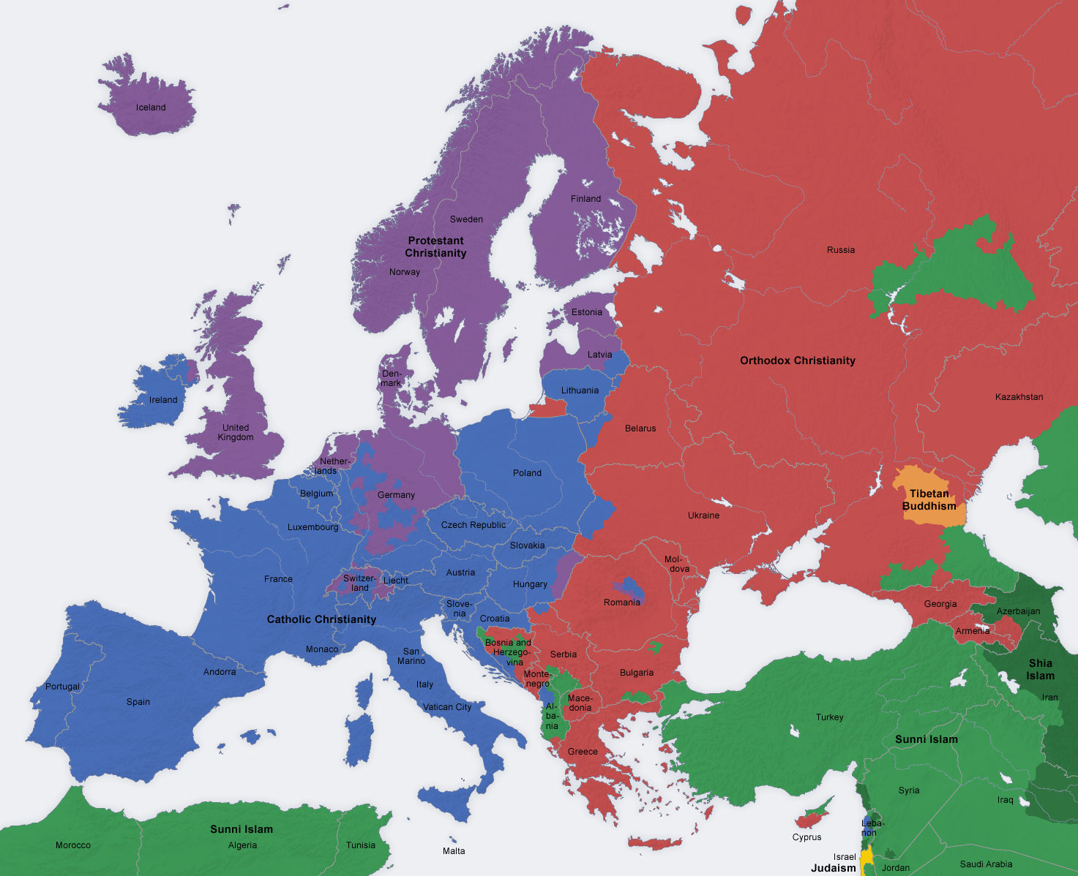
Europe – a complex continent with 4 areas
741 million inhabitants
50 countries
Western Europe – protestant
Eastern Europe – orthodox
Southern / South-Western Europe – catholic
South-Eastern Europe/Balkans – mixture of beliefs and small nations
Big challenges of Pentecostals in Europe:
How to continue to be a mission force
How to deal with the reality of being now a mission field too

Slide 6
Challenges for the future
741 million inhabitants
50 countries
Secularization
Migration:
Refugees & War
Diaspora (2.5 million Romanians)
Gypsies

Slide 7
Challenges for the future
741 million inhabitants
50 countries
3. Unevangelized areas: Balkans (Montenegro, Bosnia, Serbia)
4. Continuing to do mission outside Europe
- Decline in the number of long term missionaries

Slide 8
Statistics of belief
According to Eurobarometer (2012) Christianity is the largest religion in the EU accounting for 72% of citizens.
Roman Catholics are the largest Christian group amounting to 48% of citizens, and Protestants are 12% and Eastern Orthodox make up 8%.
Atheists are 7% and Muslims 2%, with agnostics being 16%.

Slide 9
EuropE – 4 areas
741 million inhabitants
50 countries
1. Western Europe
Pentecostal movements over 100 years old and consolidated mission agencies: UK, Scandinavia, Germany, Netherlands
Challenges: the decline in the number of churches and long-term missionaries
The secularization of society
Migration – especially Islamic

Slide 10
EuropE – 4 areas
741 million inhabitants
50 countries
Western Europe
Hope:
Missions organizations that still assist and support major missionary projects in Africa, Asia or South America
Mission leaders and missionaries that offer expertise in forming sending structures in Europe, Africa and Asia.

Slide 11
Europe – 4 areas
741 million inhabitants
50 countries
Western Europe
Hope:
Evangelism ministry among Muslim refugees
Sweden (over 3000 former Muslims believers baptized between 2015-2019; conf. Daniel Alm)
Finland (over 2000 FMB baptized between 2015-2019, most of them in Pentecostal churches; conf. Mika Yrjölä)
Germany
UK

Slide 12
Europe – 4 areas
741 million inhabitants
50 countries
2. Eastern Europe
Pentecostal movements that started at the beginning of the 20th century, but went through 50 years of communist persecution.
Young missions organizations that are now being consolidated.
Challenges: post-communist societies with weak economies and corrupt political leaders.

Slide 13
Europe – 4 areas
741 million inhabitants
50 countries
2. Eastern Europe
Challenges:
Massive migration toward the West (from Romania: 2.5 million in the last 20 years; Republic of Moldova, Bulgaria, Ukraine)
Diaspora – cultural ghettos (70 churches in Spain, 35 in Italy, over 100 NW; London – over 50; around 200-300 in total)
Broken families;
War in Ukraine;
Limited freedom in Russia and Belarus.

Slide 14
Europe – 4 areas
741 million inhabitants
50 countries
2. Eastern Europe
Hope:
The exponential growth of the Pentecostal churches in the East.
Romania: 700 (1990) to > 3200 (2023)
Russia: 750 to 6500
Ukraine: 1100 to 3600
Republic of Moldova: 60 to 380
Belarus: 170 to 730
Armenia: 45 to 420
Georgia: 32 to 140
(conf. Victor Pavlovski)

Slide 15
Europa – 4 areas
741 million inhabitants
50 countries
2. Eastern Europe
Hope:
b. New missionary sending structures
Romania: over 80 long-term missionaries in over 25 countries. More than 50% of them serve in Muslim countries.
Ukraine: after 1990, they sent over 1000 workers especially in Russia and the former USSR.
Around 60% of Pentecostal leaders in Russia are of Ukrainian origin.
Belarus: over 25 long-term missionaries.

Slide 16
Europa – 4 areas
741 million inhabitants
50 countries
3. Southern / South-Western Europe
Challenges:
Secularization
Refugees (Spain and Italy)
Pentecostal movements small in size (with the exception of Italy)

Slide 17
Europa – 4 areas
741 million inhabitants
50 countries
3. Southern / South-Western Europe
Hope:
Evangelism projects in Spain and Italy – in hundreds of locations
The birth of young mission agencies: Italy (>20), Spain, Portugal
Mission agencies from France who strongly support the missionary work in French speaking African countries.

Slide 18
Europa – 4 areas
741 million inhabitants
50 countries
4. South-Eastern Europe/Balkans
Challenges:
Great divisions – political and religious: Catholics, Orthodox and Muslim
Refugees – Turkey, Greece
Very small Pentecostal movements (Montenegro <200; Bosnia, Macedonia, Kosovo, Serbia) or young (Turkey, Albania)
Majority (or significant) Muslim population in Turkey, Albania, Bosnia, Kosovo, Bulgaria and Macedonia – mission field.

Slide 19
Europa – 4 areas
741 million inhabitants
50 countries
4. South-Eastern Europe/Balkans
Hope:
Young churches, but with vision and desire to plant churches (Albania, Bulgaria, Macedonia, Kosovo)
Missionaries that serve in the Balkans and support the national churches (RO: 13)
Mission agencies in the north-west that support the churches in the Balkans

Slide 20
Europa – 4 areas
741 million inhabitants
50 countries
4. South-Eastern Europe/Balkans
Hope:
Quality ministries among refugees in Turkey, Greece
Athens: Diaspora Pathways – discipleship, equipping Iranians and Afghans for missions (Academy of Spiritual Formation – 6 months of intensive Bible study and training, for Persian speaking refugees).

Slide 21
Europa and gypsies
741 million inhabitants
50 countries
Europe and Gypsies
There are over 12 million Gypsies in Europe. They most probably come from India. If they would be a nation, it would be 10th in Europe by size.
In 1950 a revival movement started among the Gypsies in France and Spain. There are over 2000 Pentecostal Gypsy churches in these two countries, with over 200.000 members.
Massive conversions in Romania and in the Balkans (Ro: >500 Gypsy churches).
Approximately 10% of the European Pentecostals.

Slide 22
Opportunities
There is still a lot of freedom in moving in the EU and sharing the Gospel.
The right environment to share the Good News with Muslims (e.g. Greece).
Mobilizing and equipping for evangelism and mission.

Slide 23
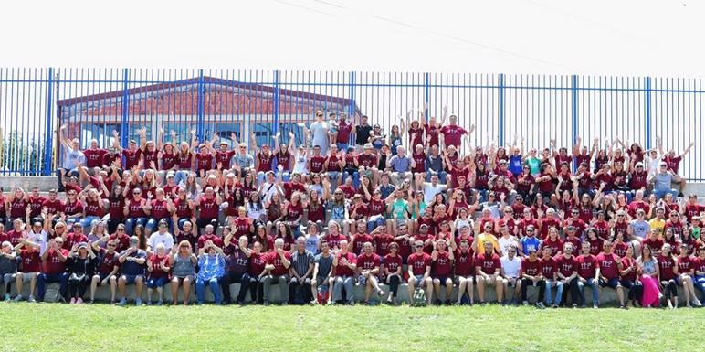
We celebrate
The existence of PEM – network of 37 organizations, since 1991
New missions organizations that send long-term workers: Romania, Italy, Ukraine, Belarus, Spain, Czech Republic etc.
3 events annually, at European level:
PEM (PEF) Consultation: 6-9 March in Warsaw, Poland
PEM Mission Course (Portugal 2022, Albania 2023))
Impact project

Slide 24
We celebrate
Kairos course (translated in many European languages and used in many churches)
Over 300 UPGs adopted for mission by PEM
Bimonthly prayer meetings
Story: Silviu Luncan & the Hazara
Romiscon 2018
Distributing UPG prayer cards
Hazara (Afghanistan)
Does God listen to prayers? How do I know that?
Visit in Indonesia in January of 2019

Slide 25
We celebrate
Cooperating with UPG Task Force in organizing a prayer framework for UPGs at European level:
Translating and sharing the UPG cards at PEM and PEF consultations and conferences; encouraging the members of PEM/PEF to adopt UPGs in prayer.
Distributing prayer calendars
Organizing once a year a 24-hour prayer chain for UPGs

Slide 26
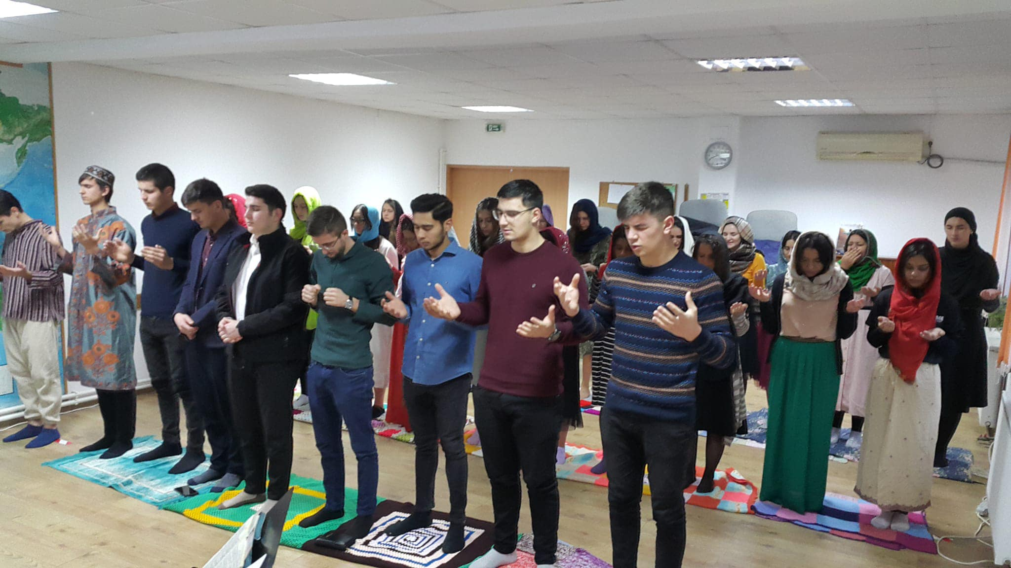
We celebrate
EQUIPING
Romanian Center for Crosscultural Studies
A 2-year program that equips people for long term missionary work
1st year – theology focused courses
2nd year – specific courses on missions (SIIR)
PEM MISSION COURSE 3-4 WEEKS EVERY YEAR
SHORT TERM MISSION TRIPS
2-4 week-long trips to various countries where people can visit career missionaries and help with their projects

Slide 27
Contact
PEM Office: Chaussée de Waterloo 45, 1640 Rhode-Saint-Génèse, BELGIUM info@pem.pef.eu
PEM Chairman: Harri Hakola
Harri.Hakola@fida.fi
PEM Vice Chairman: Gheorghe Ritisan
ghita.ritisan@gmail.com
PEM Manager of Operations: Jasmin Ovaska
jasmin.ovaska@gmail.com

