Slide 1
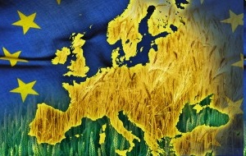
THE UNREACHED IN EUROPE

Slide 2
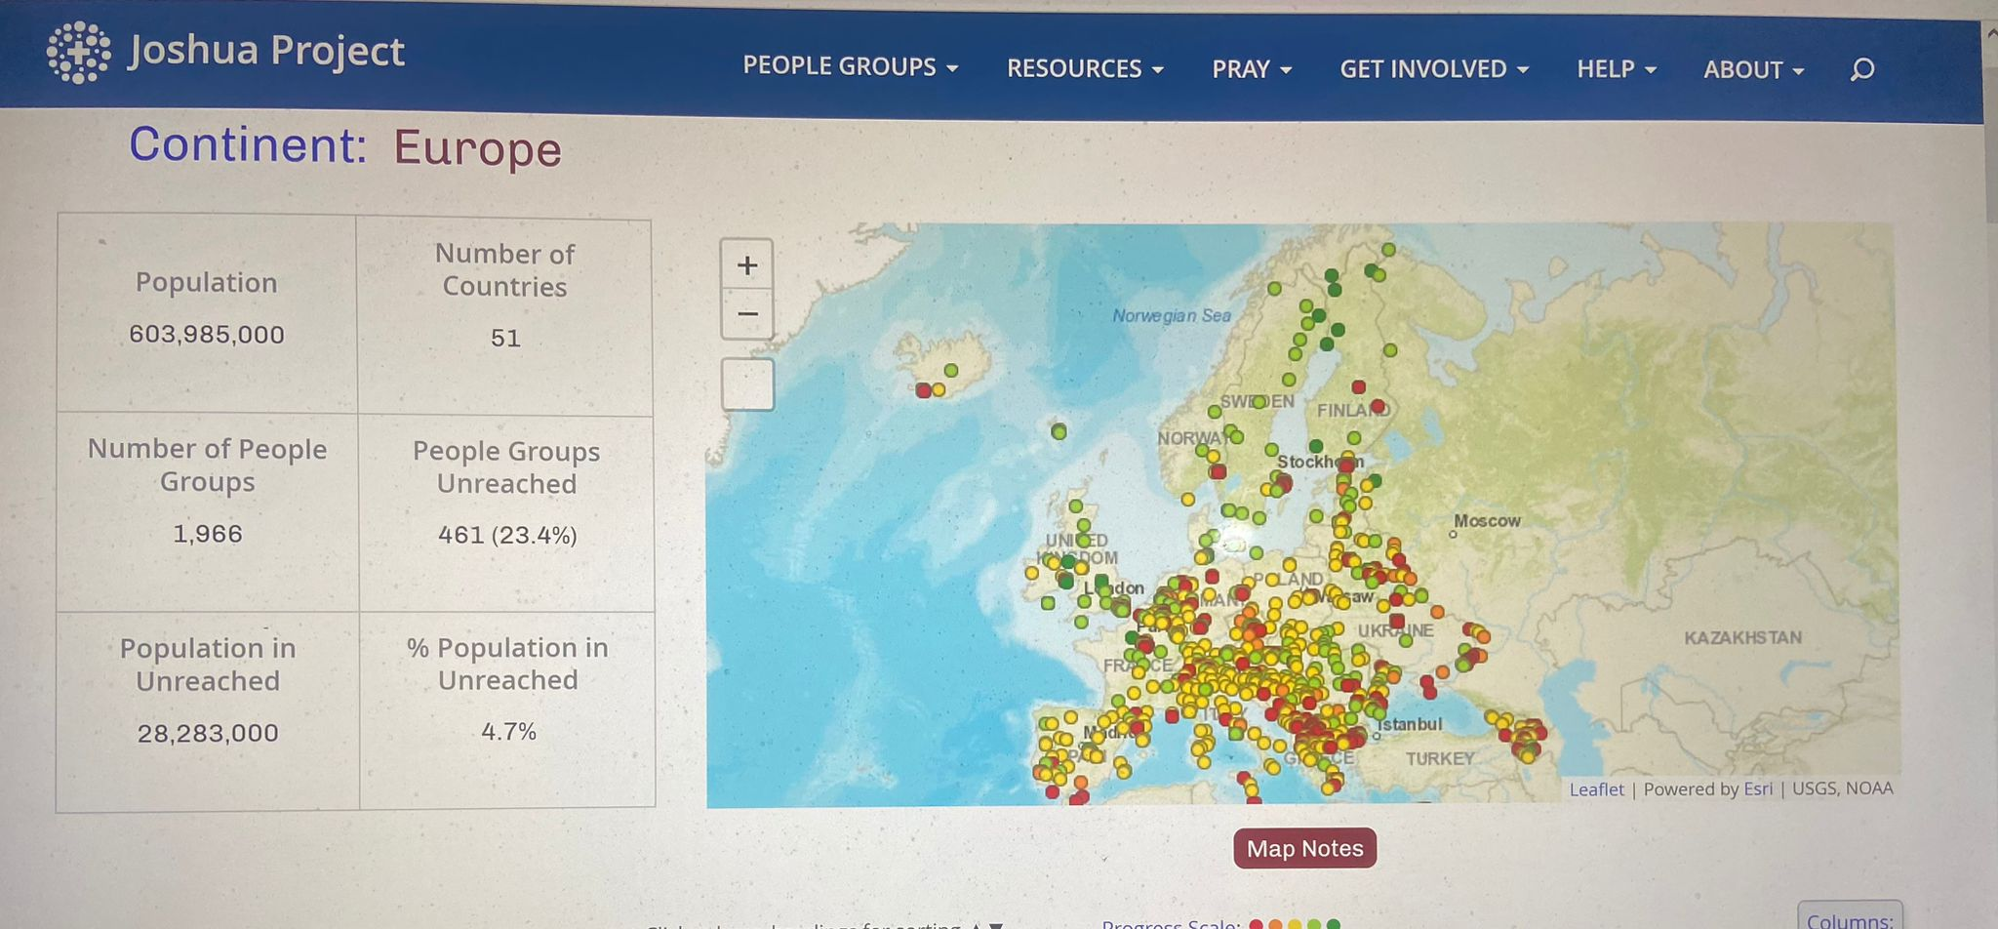

Slide 3
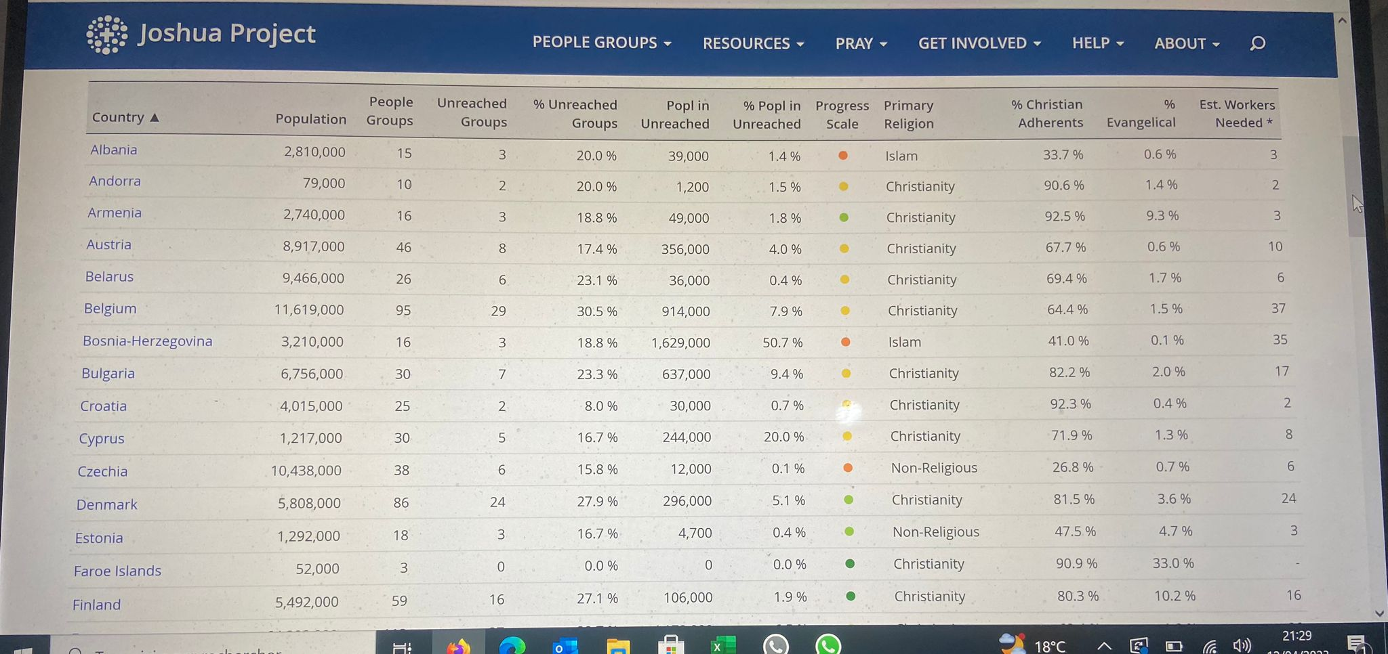

Slide 4
The Spiritual Map of Europe
* 51 countries * Over 730 million people * Over 1960 people groups
* 22 of these states have less than 1% evangelical Christians.
* 250.000 towns in Europe have NO witness of the Gospel. * Less than 1 in 10 attend any type of church.
Europe, once a main mission force,
is now a mission field!

Slide 5
Immigrants and Refugees
They have changed the face of Europe!
7 to 8 million Africans
8 million Asians
Leviticus 19:33-34 –
“When a foreigner resides among you in your land, do not mistreat them. The foreigner residing among you must be treated as your native-born. Love them as yourself, for you were foreigners in Egypt. I am the LORD your God.”
Need for an international church ministry

Slide 6
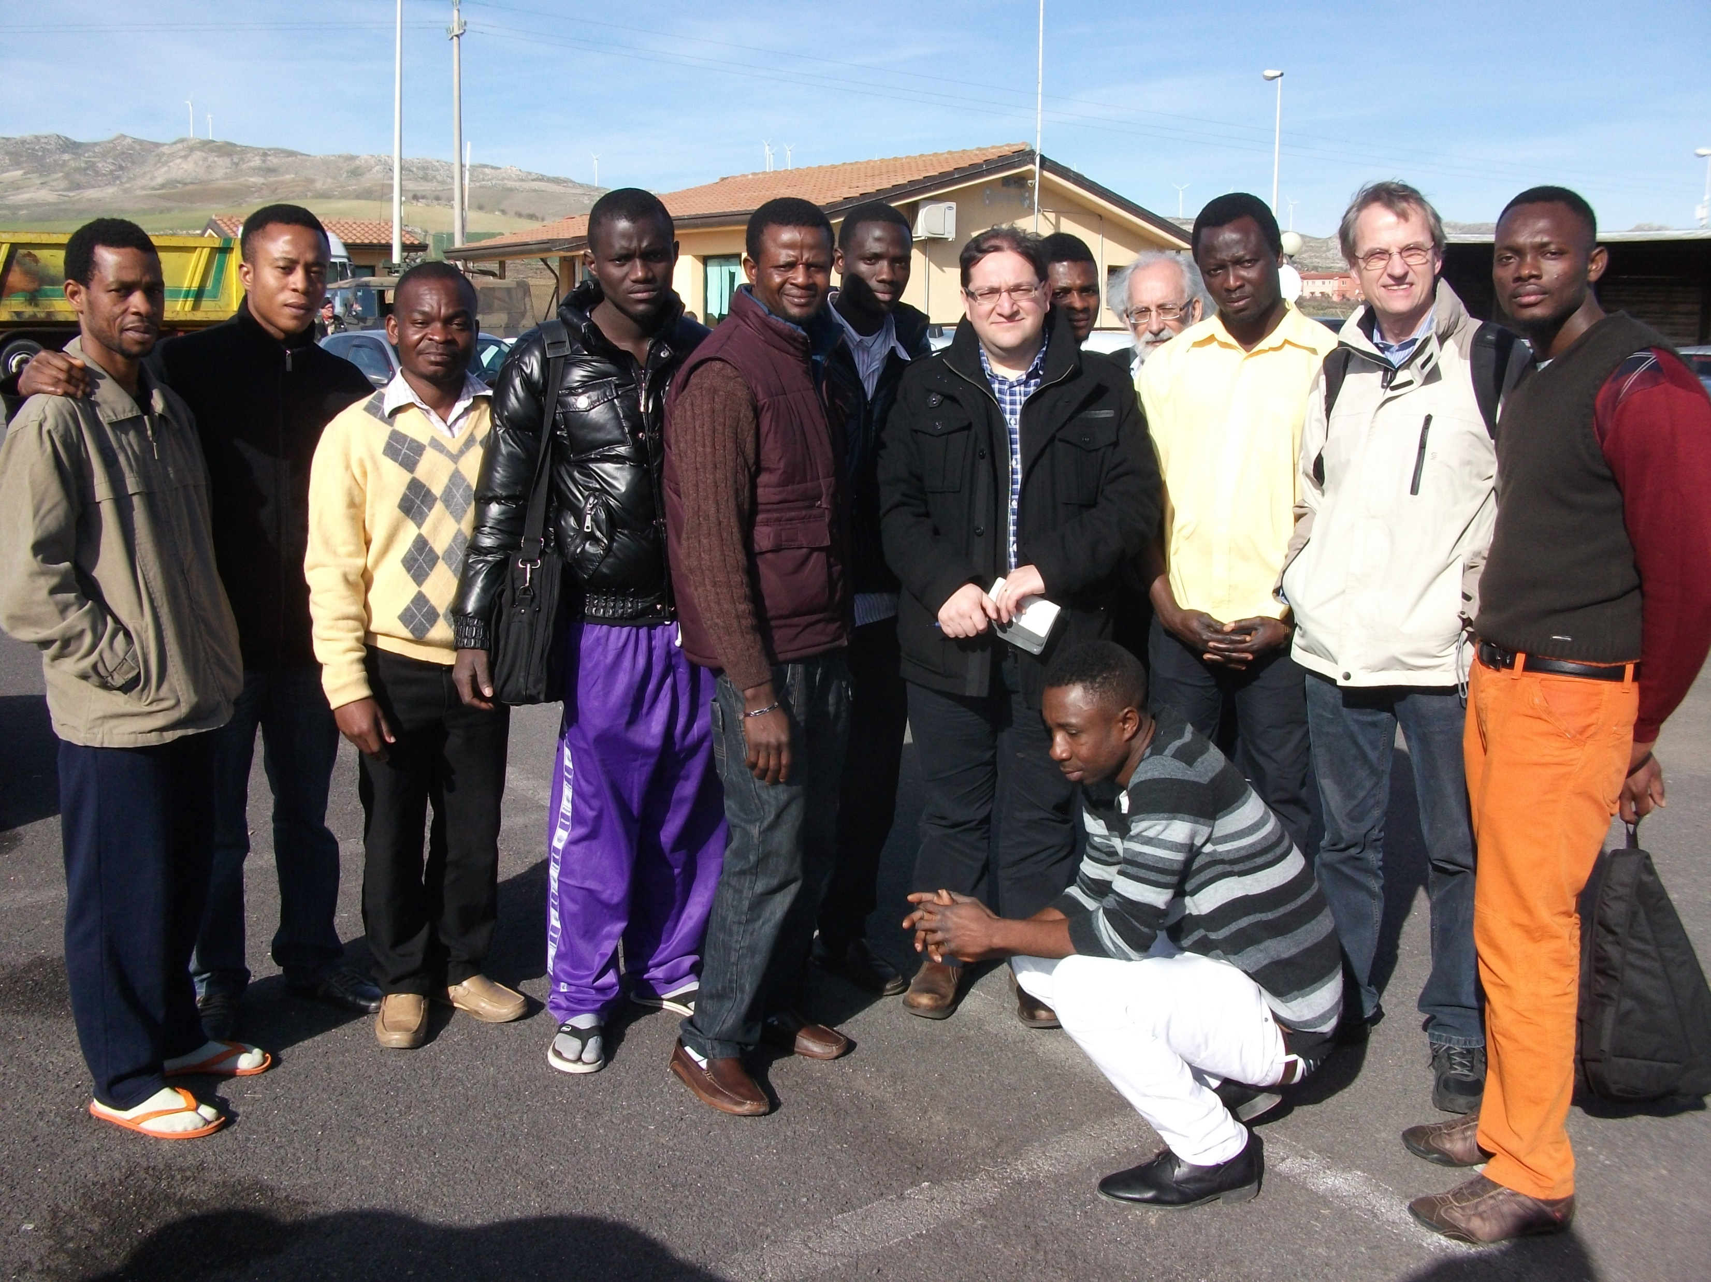

Slide 7
Human Trafficking
More than 200.000 women and girls are smuggled out of Central and Eastern Europe.
The sex industry in the Netherlands is estimated to make almost 1 billion each year.
4,000 girls are forced into the trade every year (each one is sold for 36,000 euros).
Many countries are without laws, policies, or regulations to prevent victims’ deportation.

Slide 8
Poverty in Europe
More than 185 million people in Europe live below the poverty line, especially in Central and Eastern Europe.
The number of homeless people in Western Europe is at its highest level in 50 years.
3 million people in the EU have no home, another 15 million live in poor or substandard homes.

Slide 9
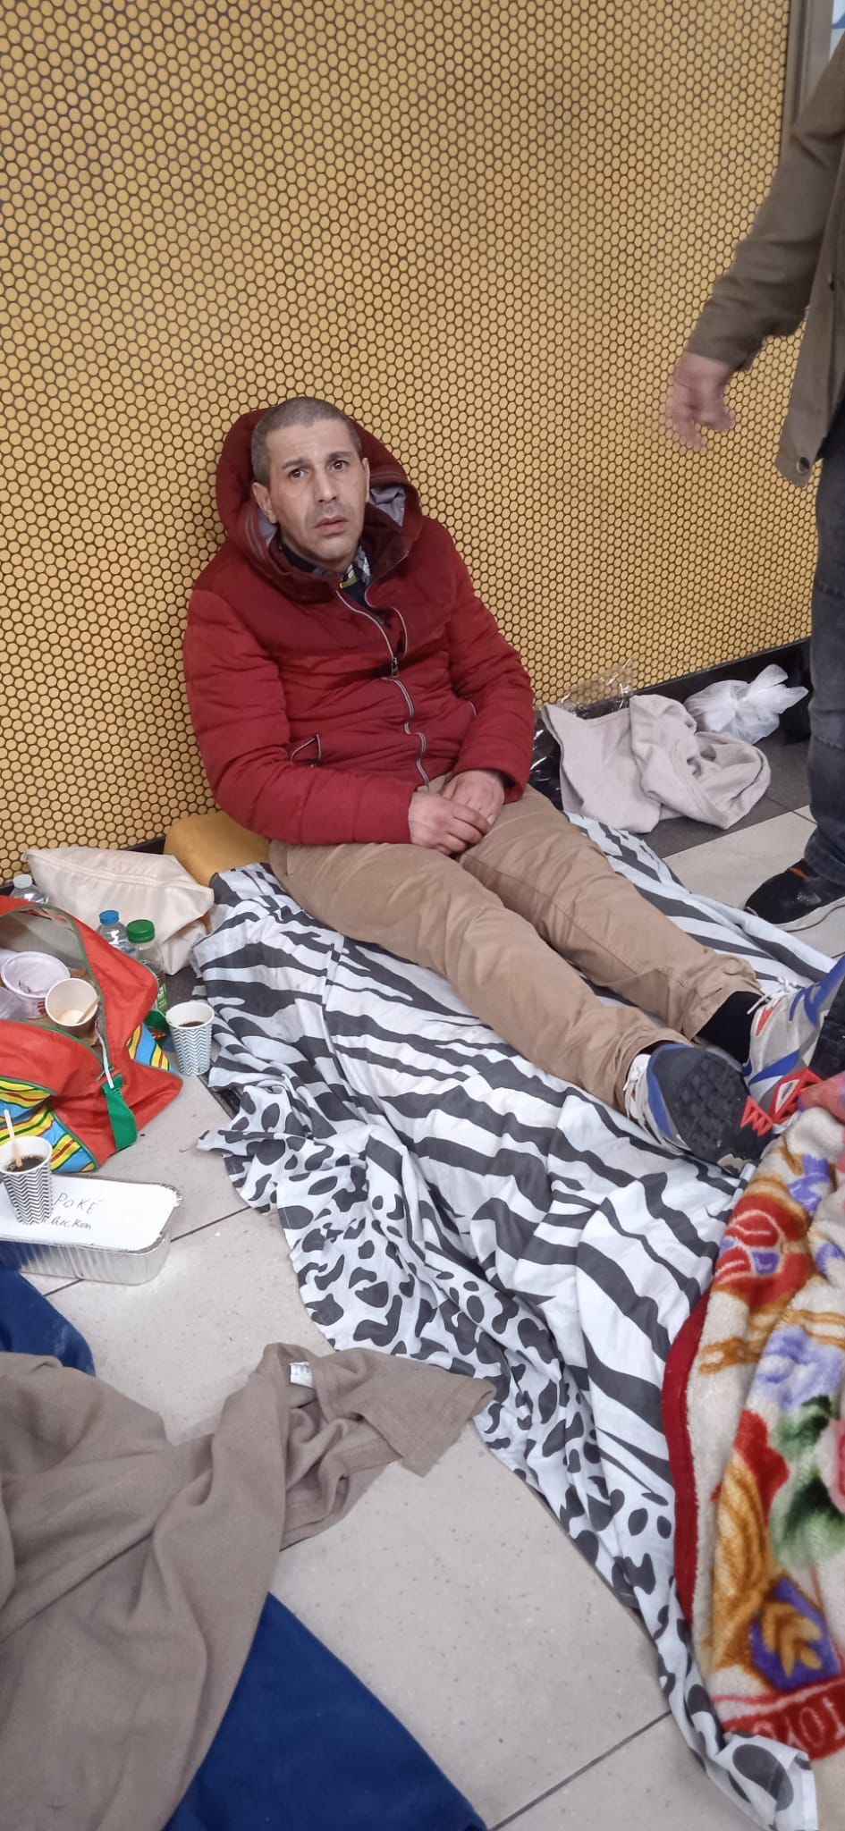
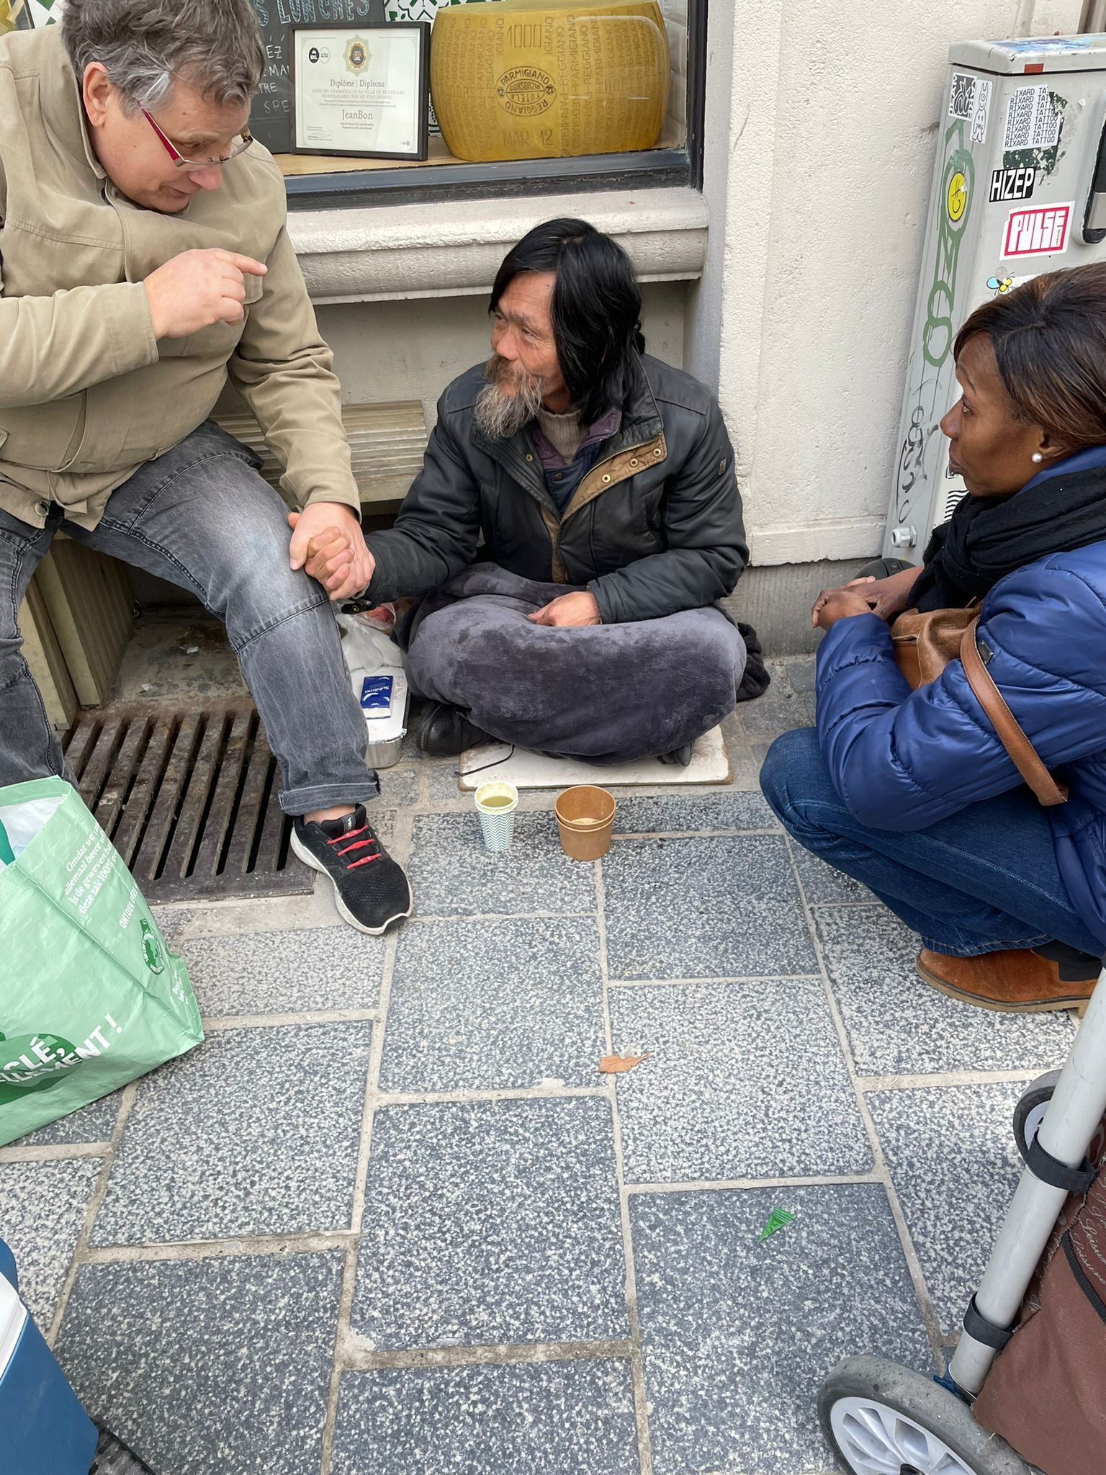
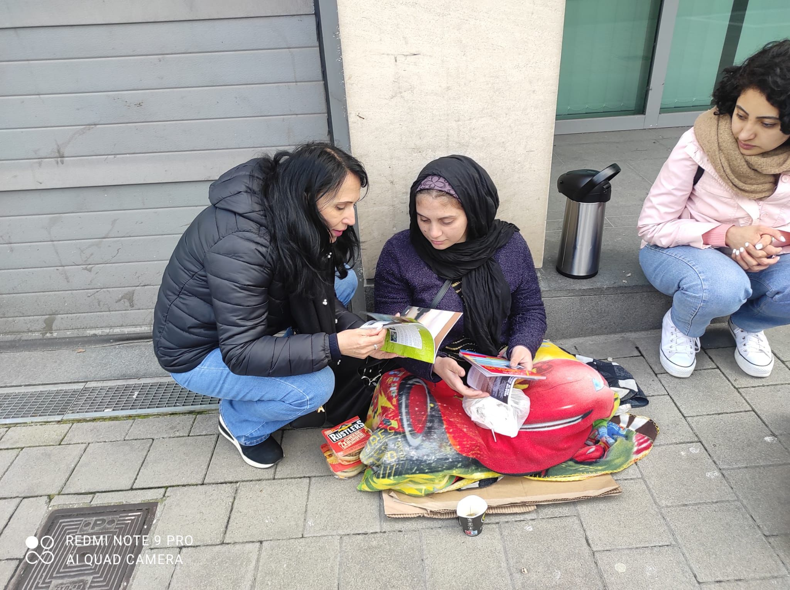

Slide 10
Islam in Europe: Threat or Opportunity?
Europe’s fastest-growing religion
Germany has 3,6 million Muslims, from more than 40 countries, with 2,200 mosques (27 in Frankfurt).
Vienna (Austria) : 1/5 of the population is Muslim.
In France: 6,5 million Muslims and more than 1,600 mosques and prayer houses (1700 in the UK).
Brussels, 1st Muslim capital of Europe.

Slide 11
Unreached People Groups
The Joshua Project lists 192 unreached groups in Western Europe, and a total of 333 in all of Europe (22 million people).
PEM UPG Strategy
Morroccans in Brussels (83.000 people)

Slide 12
The Secular Europeans
They represent the most unreached, neglected people group in Europe!
They reflect a growing gap between Generation Z and all the others in a time of accelerated cultural change.
Totally unchurched, skeptical about God, yet they are open to « spiritual experiences »

Slide 13
Mobilizing the Church to re-evangelize our continent
Notes:
13

Slide 14
WHOSE REPORT WILL YOU BELIEVE?
The negative majority: “We saw the Nephilim there… We seemed like grasshoppers in our own eyes, and we looked the same to them…”
Caleb: Then Caleb quieted the people before Moses, and said, “Let us go up at once and take possession, for we are well able to overcome it.”

