Slide 1
Urban Mission and the use of Modern Media
Accelerating the Making of Disciples and planting of churches
by the use of today´s technology

Slide 2
Urban Mission and the use of Modern Media
WHY
Urban Mission?
www.ibra.se

Slide 3
WHY Urban Mission?
IN 2022 THE LARGEST CITIES IN THE WORLD ARE:
Tokyo, Japan – the worlds most populous city Population: 37 million
Delhi, India – the second most populous city Population: 31.1 million
Shanghai, China Population: 27,7 million
Sao Paulo, Brazil Population: 22.2 million
Mexico City, Mexico Population: 21.9 million
www.ibra.se

Slide 4
WHY Urban Mission?
The Top 10 Biggest Cities By Population In 2050:
Mumbai (Bombay), India – 42,403,631
Delhi, India – 36,156,789
Dhaka, Bangladesh – 35,193,184
Kinshasa, Democratic Republic of the Congo – 35,000,361
Kolkata (Calcutta), India – 33,042,208
Lagos, Nigeria – 32,629,709
Tokyo, Japan – 32,621,993
Karachi, Pakistan – 31,696,042
New York City-Newark, USA – 24,768,743
Mexico City, Mexico – 24,328,738
www.ibra.se

Slide 5
WHY Urban Mission?
THE TOP 10 BIGGEST CITIES BY POPULATION IN 2075 ARE EXPECTED TO BE:
Kinshasa, Democratic Republic of Congo – 58,424,142
Mumbai, India – 57,862,345
Lagos, Nigeria – 57,195,075
Delhi, India – 49,338,148
Dhaka, Bangladesh – 46,218,971
Kolkata, India – 45,088,111
Karachi, Pakistan – 43,373,574
Dar Es Salaam, United Republic of Tanzania – 37,484,980
Cairo, Egypt – 32,999,203
Manila, Philippines – 32,748,758
www.ibra.se

Slide 6
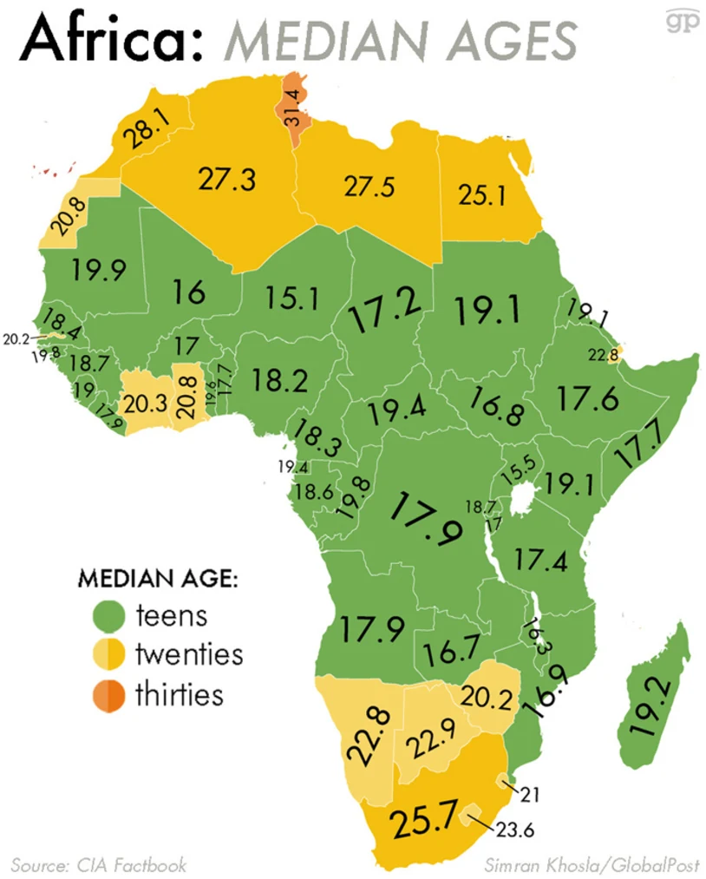
WHY Urban Mission?
AFRICA
is a
Young Continent
www.ibra.se

Slide 7
Urban Mission and the use of Modern Media
WHY
Modern Media?
www.ibra.se

Slide 8
WHY Modern Media?
Almost 60% of the world’s population uses Social Media
2H31M
Average Daily Time Spent on Social Media
www.ibra.se

Slide 9
WHY Modern Media?
Monthly Active Users
(in Millions)
Facebook 2,958
YouTube 2,514
WhatsApp 2,000
Global Figures by January 2023
www.ibra.se

Slide 10
WHY Modern Media?
3.7million+ new videos uploaded daily
www.ibra.se

Slide 11
WHY Modern Media?
There are at least 800 million videos
www.ibra.se

Slide 12
WHY Modern Media?
It would take
17,810 years
to watch every YouTube video?
And that’s assuming everyone stopped uploading new videos in the mean time!
www.ibra.se

Slide 13
WHY Modern Media?
Today
OPINION FORMS DECISIONS
MORE THAN FACTS
www.ibra.se

Slide 14
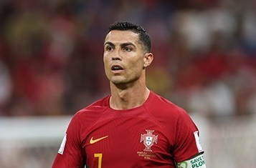
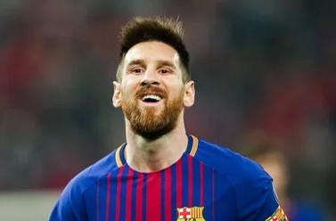
WHY Modern Media?
Most Followers on Instagram
1. | Cristiano Ronaldo | 566466833 [566.47 M] | Footballer | Portugal
2. | Lionel Messi | 446308477 [446.31 M] | Footballer | Argentina
3. | Selena Gomez | 404408570 [404.41 M] | Musician / Actress / Businesswoman | United States of America
www.ibra.se

Slide 15
WHY Modern Media?
INFLUENCERS
www.ibra.se

Slide 16
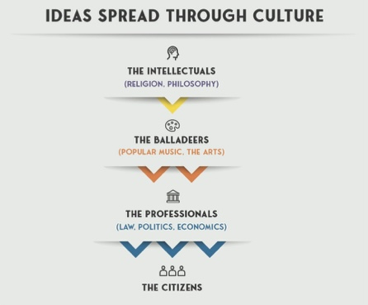
WHY Modern Media?
CULT
CULTURE
CULTIVATE
www.ibra.se

Slide 17
WHY Modern Media?
FAKE NEWS
www.ibra.se

Slide 18
WHY Modern Media?
POST TRUTH
www.ibra.se

Slide 19
WHY Modern Media?
TRUST
www.ibra.se

Slide 20
WHY Modern Media?
Almost 60% of the world’s population uses Social Media
2H31M
Average Daily Time Spent on Social Media
DO YOU
REMEMBER
www.ibra.se

Slide 21
WHY Modern Media?
Almost 60% of the world’s population uses Social Media
2H31M
Average Daily Time Spent on Social Media
MEET PEOPLE
WHERE THEY ARE
www.ibra.se

Slide 22
Urban Mission and the use of Modern Media
WHY
Making Disciples?
www.ibra.se

Slide 23
WHY Making Disciples?
God planned for a big
FAMILY
from the beginning
1Joh.4:8
GOD is LOVE
www.ibra.se

Slide 24
WHY Making Disciples?
JESUS
COMMANDED
US
Math.28:18-20
Great Commission
www.ibra.se

Slide 25
Urban Mission and the use of Modern Media
HOW
Do we make Disciples
In Urban context using Social Media?
www.ibra.se

Slide 26
HOW do we Make Disciples in Urban context?
KNOW
your
AUDIENCE
www.ibra.se

Slide 27
HOW do we Make Disciples in Urban context?
Age
Education
Religion
Interest
Needs
WHERE are they meeting?
GO to where they are!
www.ibra.se

Slide 28
HOW do we Make Disciples in Urban context?
Paul knew his Audience
Acts.17:16-23
www.ibra.se

Slide 29
HOW do we Make Disciples in Urban context?
5
L
LOVE
LOOK
LISTEN
LEARN
LINK
www.ibra.se

Slide 30
HOW do we Make Disciples in Urban context?
PARADIGM
SHIFT
From - Deliver a message
To - Explore/Discover together
From - The presenters perspective
To - Consumers needs
www.ibra.se

Slide 31
HOW do we Make Disciples in Urban context?
PARADIGM
SHIFT
From - Content controlled by the media developer
To - Content controlled by the user’s choice.
www.ibra.se

Slide 32
HOW do we Make Disciples in Urban context?
PARADIGM
SHIFT
New Media is seeker centric
not program centric
New Media is Interactive
www.ibra.se

Slide 33
HOW do we Make Disciples in Urban context?
The INFORMATION
Noise
1.13 billion
Websites in the World
252,000
new websites are created every day
www.ibra.se

Slide 34
HOW do we Make Disciples in Urban context?
The INFORMATION
Noise
300+ million
photos get uploaded per day.
510,000
comments posted every day
293,000
statuses updated.
www.ibra.se

Slide 35
HOW do we Make Disciples in Urban context?
The INFORMATION
Noise
30,000
Internet radio stations
5000
TV Channels LIVE from 180 countries (available on one website)
www.ibra.se

Slide 36
HOW do we Make Disciples in Urban context?
The INFORMATION
Noise
800 million
videos on YouTube. 3,7 Million new daily
4,4 million
new blog posts are published every day across all platforms.
www.ibra.se

Slide 37
HOW do we Make Disciples in Urban context?
The INFORMATION
Noise
WHY
Would someone listen to YOU?
www.ibra.se

Slide 38
Social Media for Disciple Making
Learn How
Social Media is NOT PREACHING!
Not even Lecturing
Social Media is about…..
Story telling
www.ibra.se

Slide 39
Social Media for Disciple Making
Learn How
Welcome people to Interact with YOUR story
Tell what is unique, exciting, relevant, worth discussing,
www.ibra.se

Slide 40
Social Media for Disciple Making
Learn How
Tell YOUR story within HIS (God’s) story
Give a glimpse how God fits into your story
www.ibra.se

Slide 41
Social Media for Disciple Making
LISTEN
Monitor Social Media conversations.
What are people saying about the topic you want to get across?
www.ibra.se

Slide 42
Social Media for Disciple Making
LISTEN
Pay attention to:
Needs
Challenges
Preferences
www.ibra.se

Slide 43
Social Media for Disciple Making
CREATE
Share:
Useful
Relevant
Engaging
content, that resonates with your audience
www.ibra.se

Slide 44
Social Media for Disciple Making
CREATE
Use:
Images
Videos
to capture attention and convey your message
www.ibra.se

Slide 45
Social Media for Disciple Making
CREATE
Be short
Be Personal
Be Positive (The bigger YES!)
Encourage dialogue/comments
www.ibra.se

Slide 46
Social Media for Disciple Making
RESP
OND
Reply promptly to:
Comments
Questions
Messages
In a timely and respectful manner.
www.ibra.se

Slide 47
Social Media for Disciple Making
RESP
OND
Show appreciation
for
Positive Feedback
www.ibra.se

Slide 48
Social Media for Disciple Making
RESP
OND
Address Negative Comments
with
EMPATHY
and
PROFESSIONALISM
www.ibra.se

Slide 49
Social Media for Disciple Making
DIALO
GUE
Encourage conversations
Invite feedback
Share your own perspectives
www.ibra.se

Slide 50
Social Media for Disciple Making
DIALO
GUE
ASK – “What will you do with what you have learned?” (How will you implement)
ASK – “Who will you tell what you have learned?”
www.ibra.se

Slide 51
Social Media for Disciple Making
DIALO
GUE
Open the door to
one on one conversation.
www.ibra.se

Slide 52
Social Media for Disciple Making
DIALO
GUE
When we deal with Biblical topics – Encourage formation of Discovery Bible Study group (online or off line)
www.ibra.se

Slide 53
Social Media for Disciple Making
DIALO
GUE
Use hashtags #
To increase visibility and reach a broader audience
www.ibra.se

Slide 54
Social Media for Disciple Making
RELA TION SHIPS
ENGAGE with
Influencers and Ambassadors of your MISSION
www.ibra.se

Slide 55
Social Media for Disciple Making
RELA TION SHIPS
COLLABORATE with them on campaigns
www.ibra.se

Slide 56
Social Media for Disciple Making
RELA TION SHIPS
SHARE
their content, while acknowledging their contribution to your cause.
www.ibra.se

Slide 57
Social Media for Disciple Making
MEA
SURE
Use social media Analytics tools to track:
Likes
Shares
Comments
Mentions
www.ibra.se

Slide 58
Social Media for Disciple Making
MEA
SURE
Use insights
to adjust strategy and improve engagement over time.
www.ibra.se

Slide 59
Social Media for Disciple Making
REME
MBER
Social Media
is a
TWO-WAY Conversation
www.ibra.se

Slide 60
Social Media for Disciple Making
REME
MBER
Listen
Engage
Build Relationships
www.ibra.se

Slide 61
Social Media for Disciple Making
PLAN
Have a Plan
Publish Regularly
Respond Promptly.
Use available material
www.ibra.se

Slide 62
Social Media for Disciple Making
GO
Social Media happens in “Bubbles”.
Traditionally we try to pull people into our Bubbles.
Go OUT from your Bubble – Enter THEIR “Bubble”.
www.ibra.se

Slide 63
Social Media for Disciple Making
GO
Interact respectfully and lovingly in their space.
Ask QUESTIONS.
Gently nudge the conversation to where you want it to go.
www.ibra.se

Slide 64
Social Media for Disciple Making
GO
Don’t see yourself as the producer
We can ALL produce content and interact in appropriate forums.
www.ibra.se

Slide 65
Social Media for Disciple Making
GO
Teach and mentor
young people (your friends) to use these tools strategically to make Disciples among their friends.
Model and share
what you learn.
www.ibra.se

Slide 66
Social Media for Disciple Making
Make
DISCIPLES
Think Strategic
Think
The Disciple Journey
www.ibra.se

Slide 67
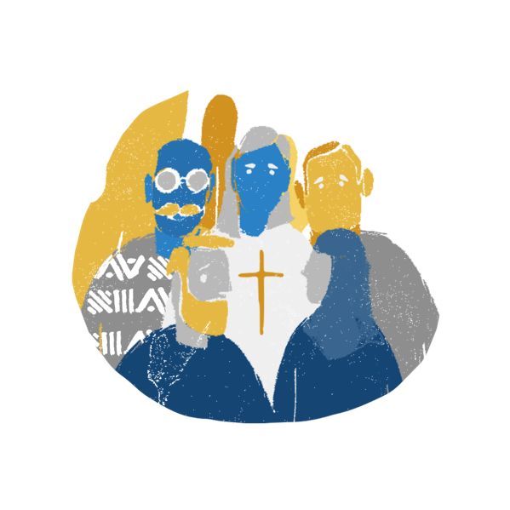
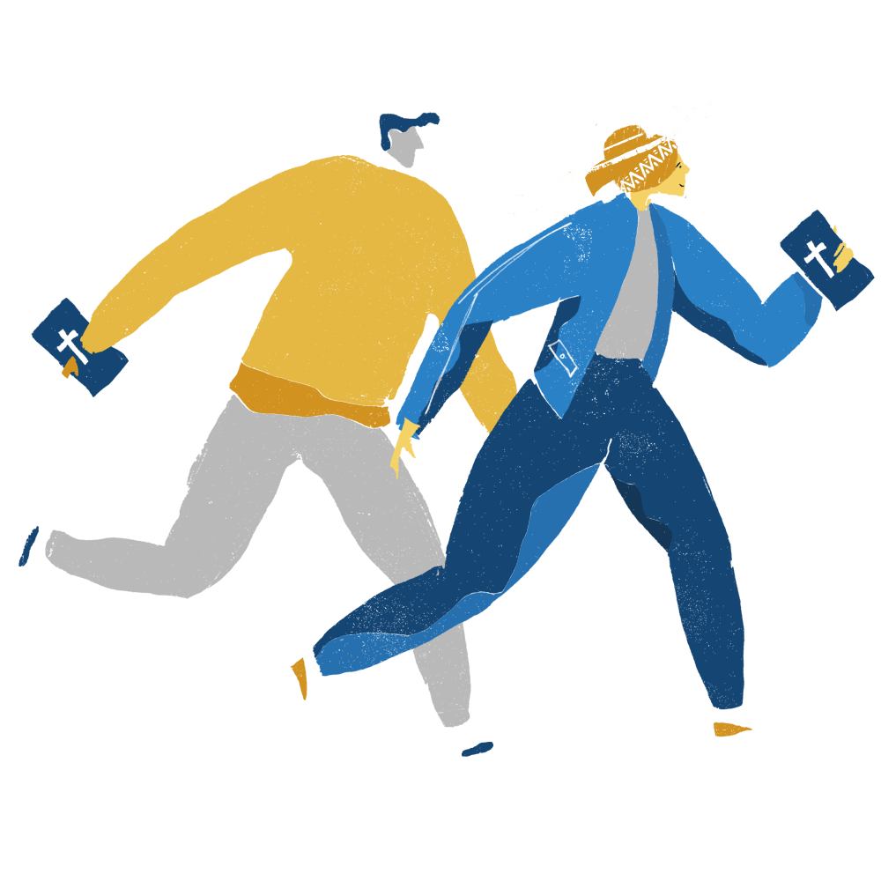
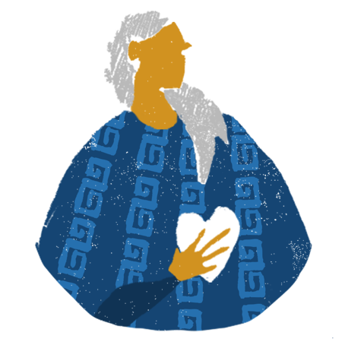
The Disciple Journey
Multiplying Disciples
Plant Church
Strategic Prayer
Identify Key Persons
Develop Leaders
Discovery Bible Study Groups
Engage the Target Audience
Notes:
Manus:
Niclas: Behöver beskriva varför och DNA i manuset.

Slide 68
Social Media for Disciple Making
Make
DISCIPLES
Online MUST at some point lead to Offline.
Real People
Real Relationships
Real DBS groups and churches
www.ibra.se

Slide 69
HOW do we Make Disciples in Urban context?
Make
DISCIPLES
Keep the
FOCUS
right!
www.ibra.se

Slide 70
HOW do we Make Disciples in Urban context?
Make
DISCIPLES
Don’t follow footsteps
Create them!
www.ibra.se

Slide 71
HOW do we Make Disciples in Urban context?
INSP
IRATION
ORDINARY PEOPLE
YouTube IBRA MISSION
www.ibra.se

Slide 72
HOW do we Make Disciples in Urban context?
INSP
IRATION
www.ibra.se

Slide 73
HOW do we Make Disciples in Urban context?
INSP
IRATION
DMM Training Videos
www.ibra.se

Slide 74
HOW do we Make Disciples in Urban context?
INSP
IRATION
ON LINE Strategy
www.ibra.se

Slide 75
HOW do we Make Disciples in Urban context?
THANK YOU
E-mail
janerik.nyman@ibra.se
WhatsApp
+255754447571
www.ibra.se

Slide 76
www.ibra.se

